Slide 1
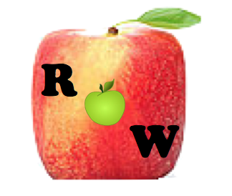
RipeOrWrong
Using Deep Learning Networks to Determine the Quality of Fruits and Vegetables Using Thermal Imaging
Tyler Kaye ‘18
Advisor: Alan Kaplan
COS IW03: Random Apps of Kindness

Slide 2
Motivation
US Dept. of Agriculture estimates that retailers lose ~$15 billion in fruit and ~$18 billion in vegetables due to quality standards. (2011)
25% of fruits and vegetables are thrown out in the US, 2/3 of which are due to poor quality
D. Gunders, “Wasted: How america is losing up to 40 percent of its food from farm to fork to landfill.”
Poor Quality Fruits == Waste of Time and Money

Slide 3
Goal
Prevent consumers from wasting time and money on un-ripened and/or blemished fruits and vegetables

Slide 4
Related Work
Thermal Detection
S. Sumriddetchkajorn et al: “Two-dimensional fruit ripeness estimation using thermal imaging.” (2013)
Thermal imaging over 4 minutes
me
Convert radiant flux to a measure of thermal emissivity in order to tell ripeness of batch
Visual Detection:
T. Susnjak, et al: “A Decomposition Machine-learning Strategy for Automated Fruit Grading” (2013)
ML successful identifying visible blemishes
N. El-Bendary et al. , “Using machine learning techniques for evaluating tomato ripeness.” (2014)
Visual spectrum is not sufficient for detection of bruising / ripeness of tomatoes
Spectral Detection:
H.Wang et al. “Fruit Quality Evaluation Using Spectroscopy Technology: A Review” (2015)
Use spectroscopy, multispectral imaging, and hyperspectral imaging → “chemometrics”
J. Qin and R. Lu, “Detection of pits in tart cherries by hyperspectral transmission imaging,” (2005)
Spectral imaging capable of pit detection
Consumer Applications:
A. Wahi et al: “Wisci: Wireless spectrometer.” (2016)
L. Rothman, “This pocket-sized sensor will tell you when fruit is ripe.” (2014)
WISci and Scio: Hardware application to build portable spectrometers
Determine chlorophyll composition → ripeness = No machine learning techniques
Problem: Spectrometers will not be portable or cost-effective in the near future

Slide 5
Approach
Combine mobile thermal imaging technology and machine learning capabilities to improve the detection of poor fruit quality
Initially focus just on apples
Develop a modularized framework to seamlessly add new fruits and vegetables to the model and application

Slide 6
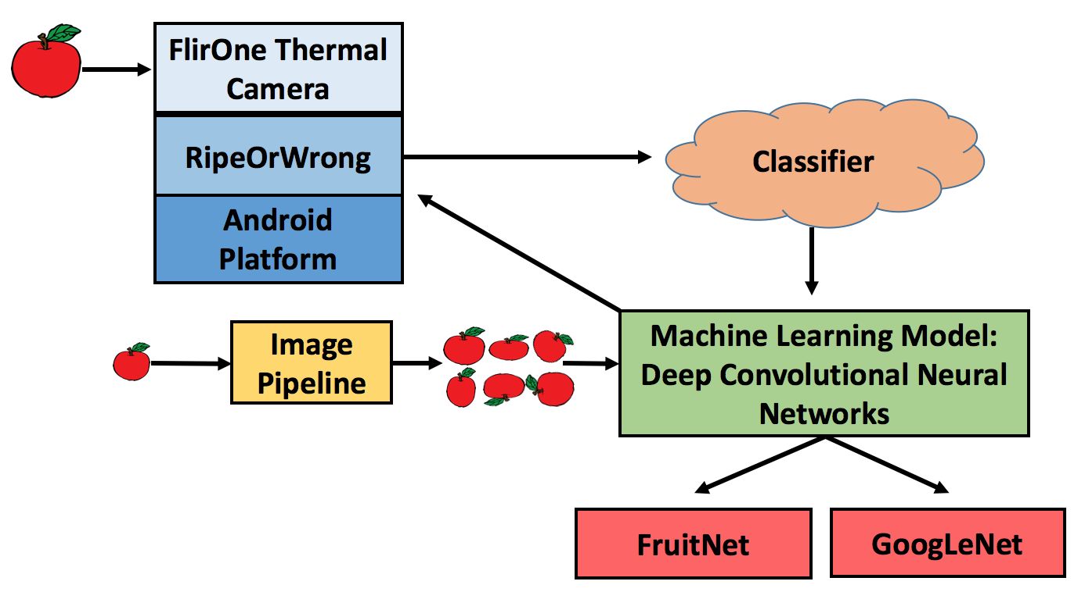
Implementation: System Architecture

Slide 7
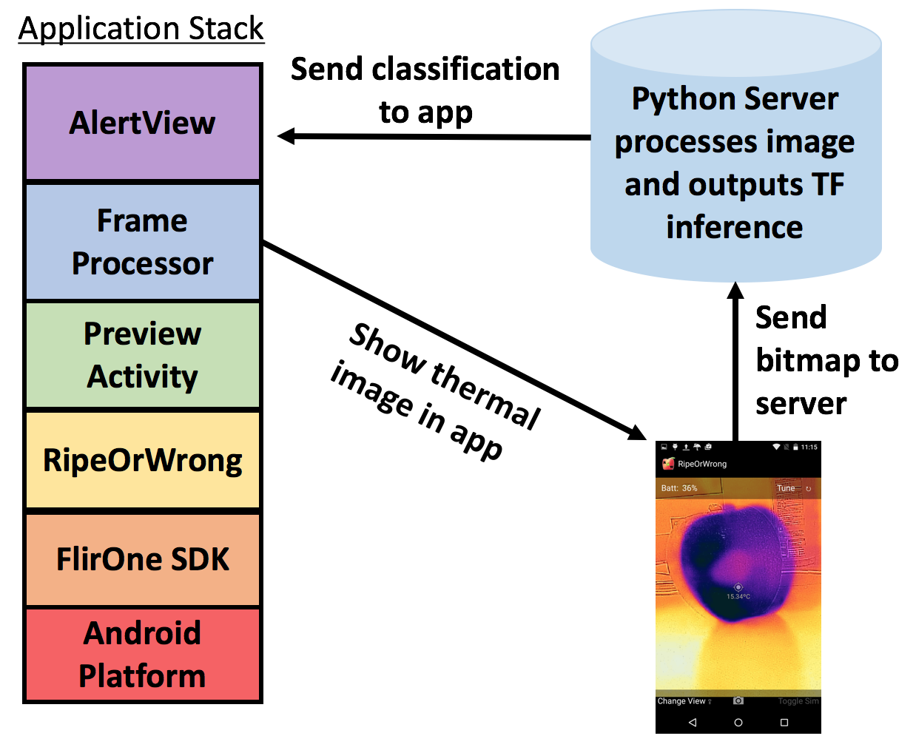
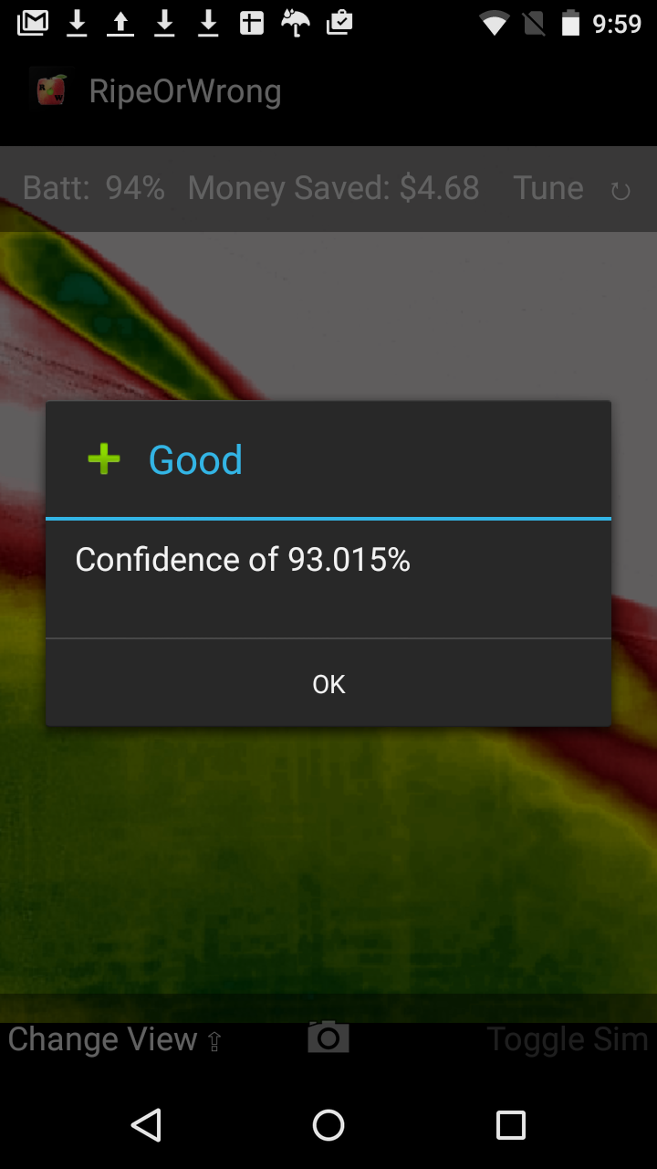
Implementation: Mobile Application
Alert user of the output of the classifier
Keep track of how much money is saved

Slide 8
Implementation: Classifier
Python server running in AWS EC2
Takes photo → resizes → runs through neural network
Send back the results of the model
Problems:
How to train the model? → Image pipeline for dataset
What model to use? → FruitNet or GoogLeNet

Slide 9
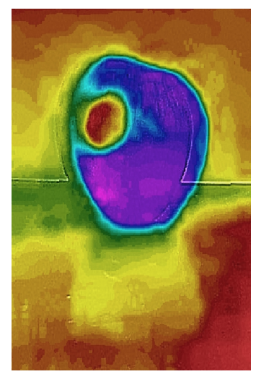
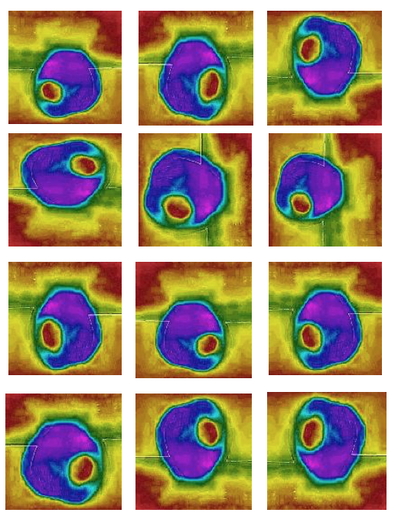
Implementation: DataSet and Image Pipeline
Want to train the network with images from FLIR camera
Turn 50 images into 30,000 permutations with SeamCarver
Teach translational and rotational invariance
Pseudo Algorithm
For each image in dataset:
Generate 100 permutations using SeamCarver
For each permutation:
Generate 6 rotations of image
Original image
12 Sample permutations

Slide 10
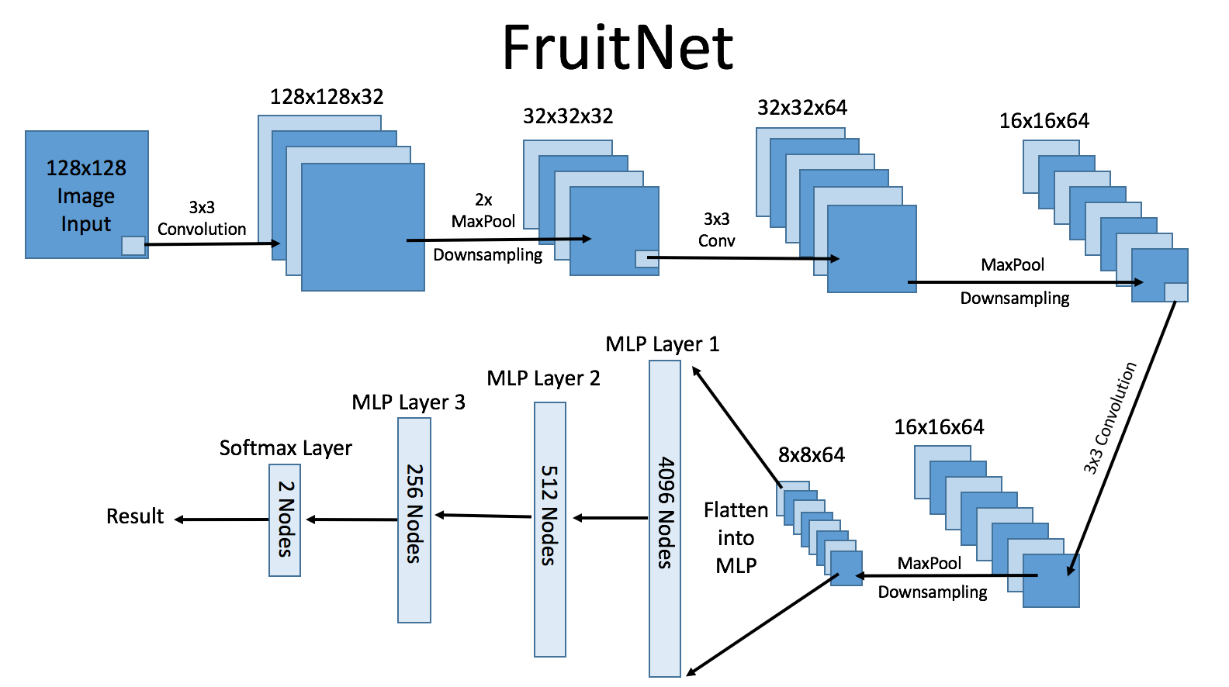
Implementation: FruitNet

Slide 11

Making The Process of Adding a New Fruit Seamless?
GoogLeNet Re-Training
Python script re-trains this model by just adding a final output layer and training just this layer → incredibly advanced feature detection

Slide 12
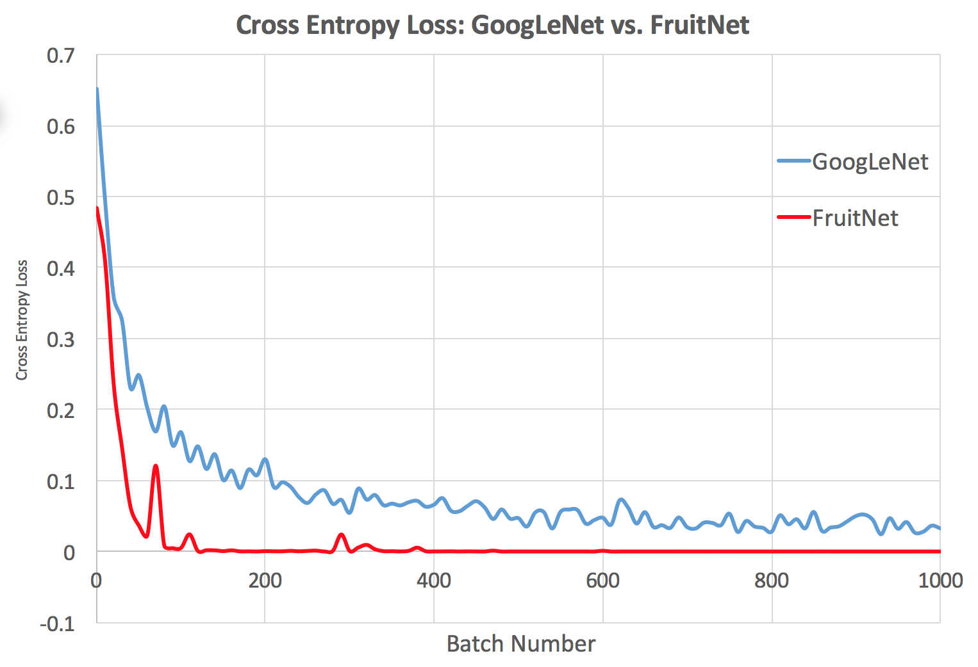
Results: Cross Entropy Error Function

Slide 13
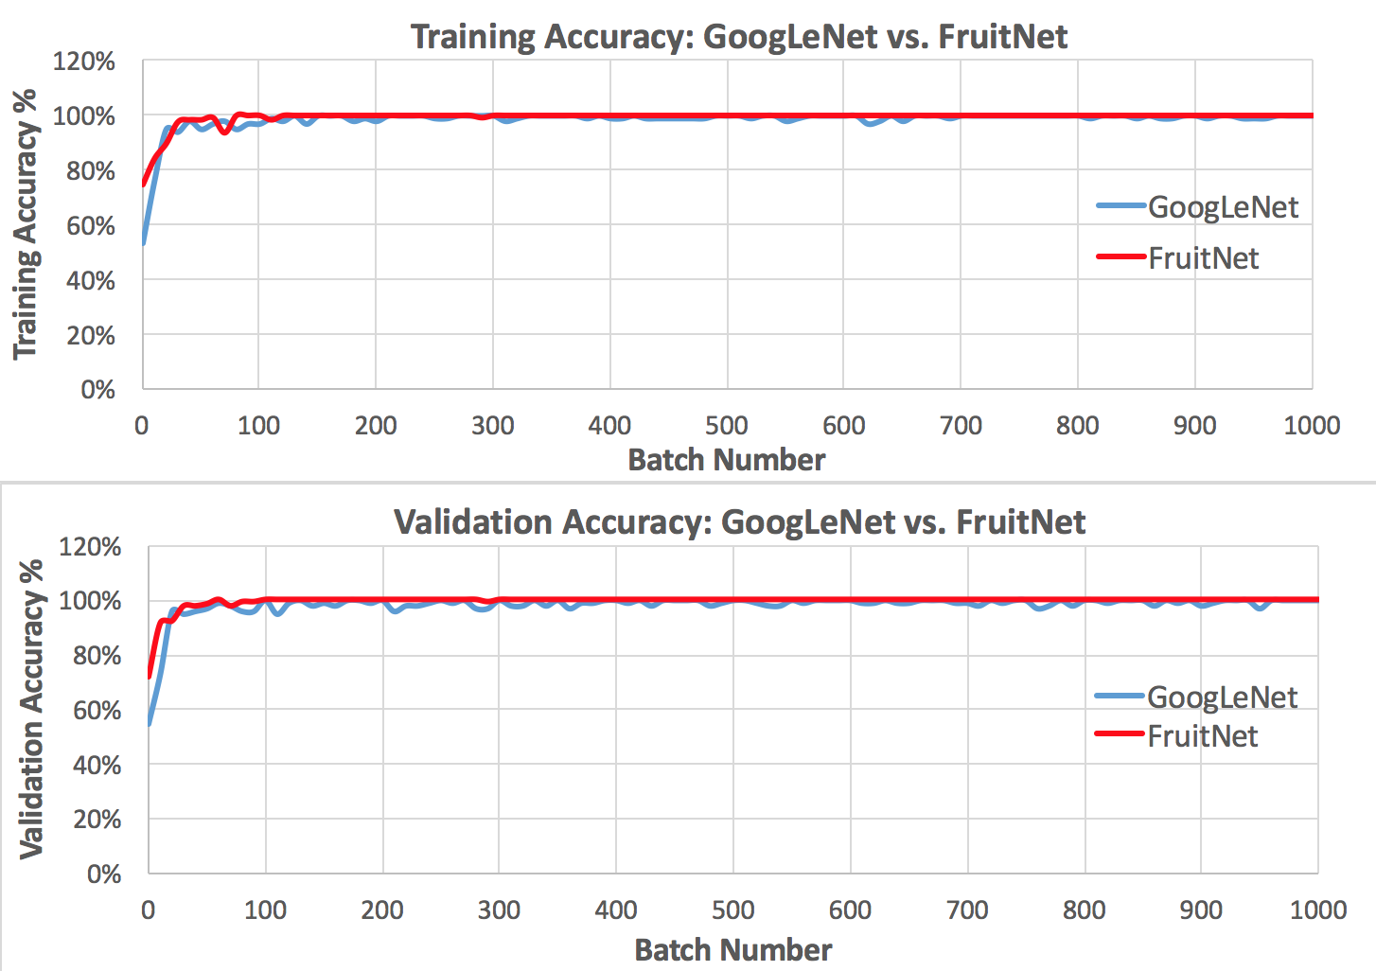
Results: Validation and Training Accuracy

Slide 14
Conclusions: FruitNet vs. GoogLeNet
FruitNet outperformed GoogLeNet in terms of minimizing cross entropy loss
They performed similarly in terms of training and validation error
GoogLeNet makes re-training incredibly simple:
Faster, easier, and more efficient (already trained feature maps)

Slide 15
Conclusions
It is possible to detect below the surface bruising in apples, but it is more challenging to detect ripeness
By placing the model in a server as opposed to the physical application the model can be seamlessly updated to include new fruits and vegetables
Model also detects bruising on peaches, plums, tomatoes, and other similarly shaped fruits and vegetables
Objects and heat sources in the background (hands) limit the model’s ability to generalize and perform accurate inferences

Slide 16
Future Work:
Background stripping
Adding new fruits and vegetables
Implement TensorFlow locally on Android

Slide 17

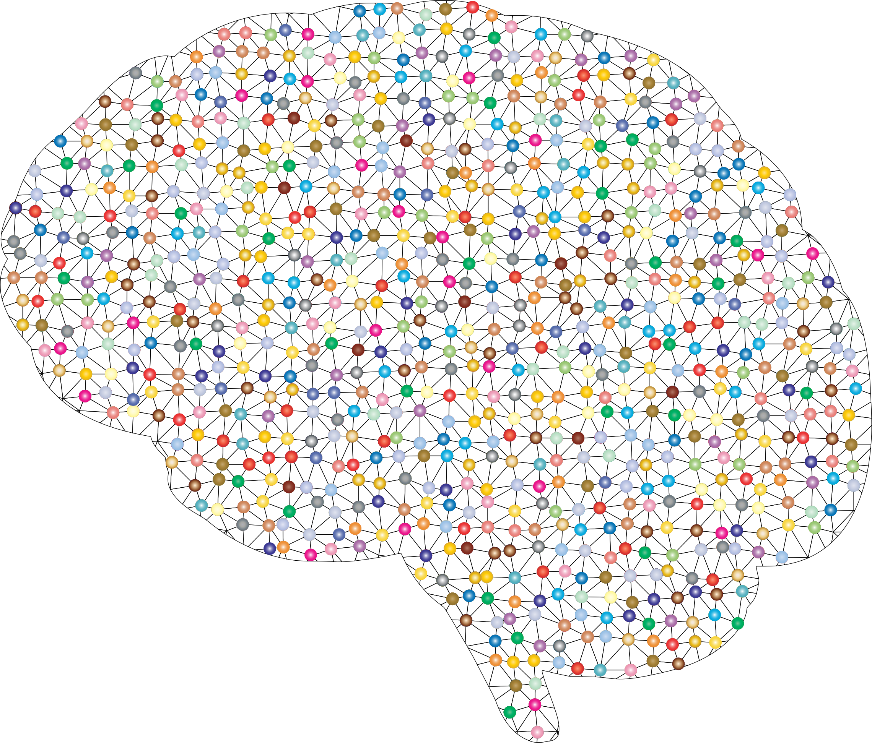
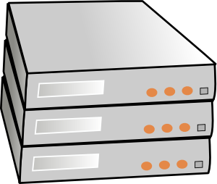
OPTIONAL: Developer Flow: Add New Fruit
30,000 Images
50 Images
Image
Train
Put model
Pipeline
Network
on server

